Slide 1
Bank Performance Analysis

Slide 2
Profitability Analysis

Slide 3
Measuring Performance of Commercial Banks
Performance refers to how adequately the bank meets the needs of its stockholders (owners), employees, depositors and other creditors and borrowing customers
Bank performance measures are evaluated with help of the Income Statement and Balance Sheet

Slide 4
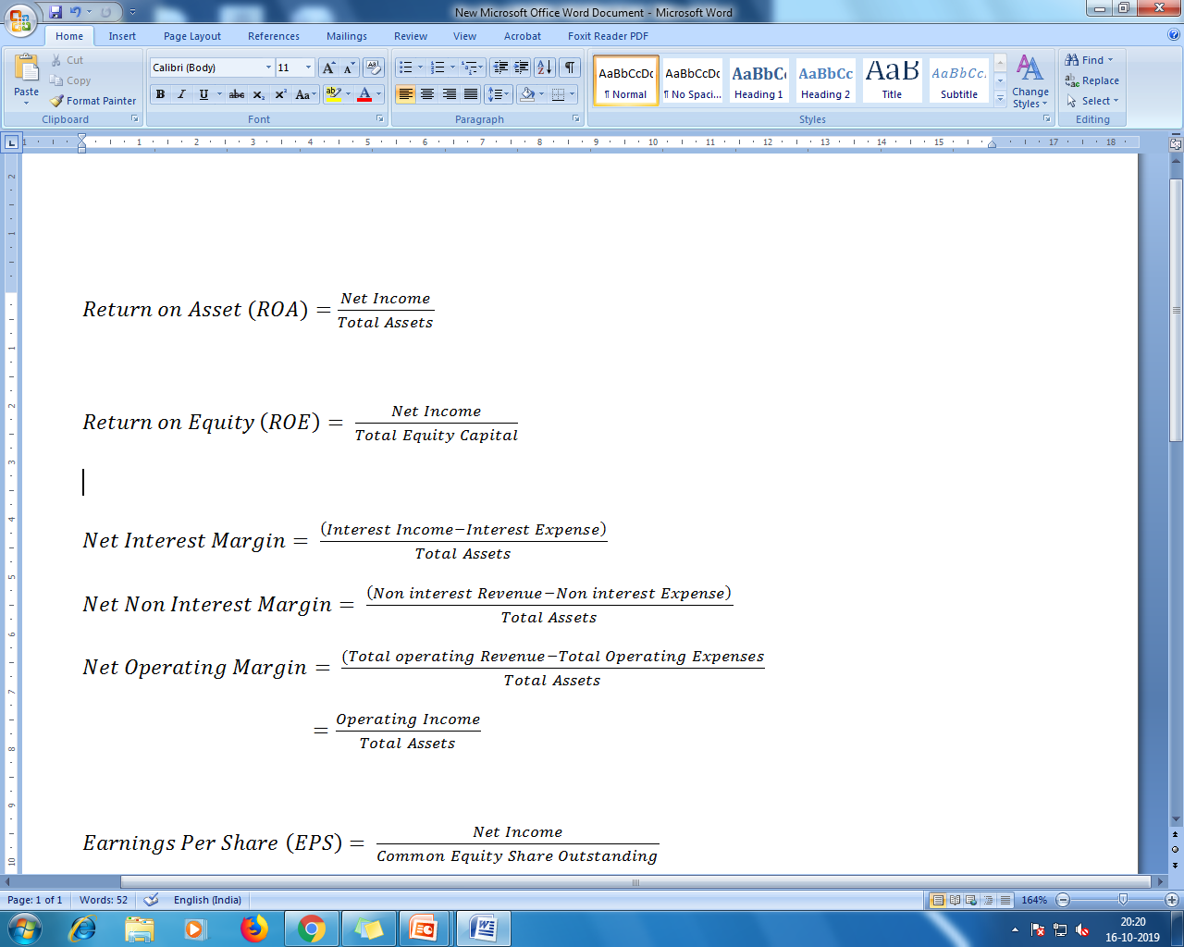
Profitability Ratios
ROA is an indicator of managerial efficiency
It indicates how capable management has been in converting assets into net earnings

Slide 5
Profitability Ratios Cont..
ROE is a measure of the rate of return flowing to shareholders
It approximates the net benefit that the shareholders have received from investing their capital in the financial firm

Slide 6
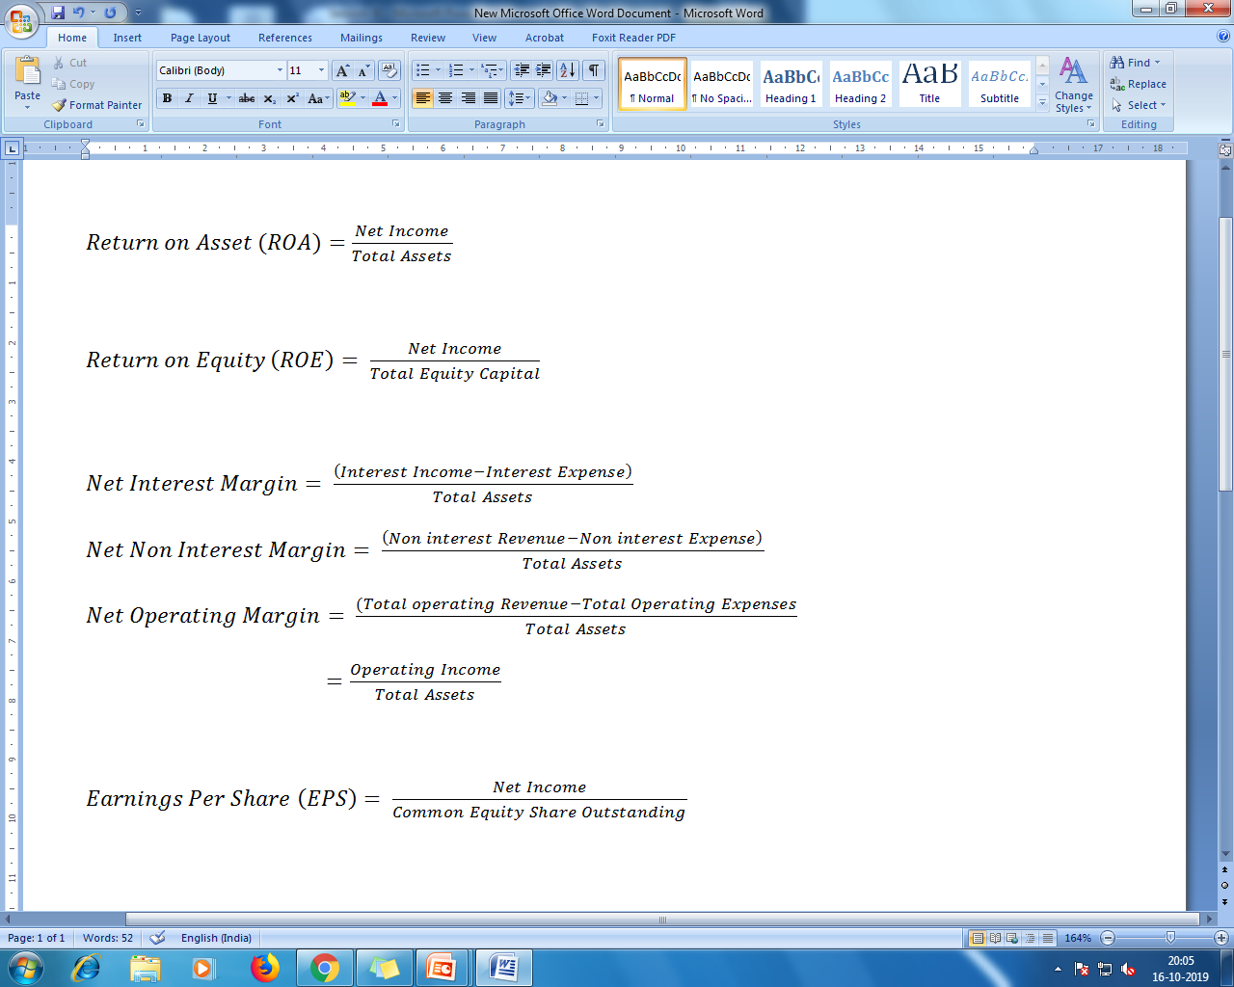
Profitability Ratios Cont..
These are efficiency as well as profitability measures
They indicate how well the management and staff have been able to keep the growth revenue ahead of rising costs

Slide 7
Profitability Ratios Cont..
The net interest margin measures how large a spread between interest revenue and interest cost management has been able to achieve close control over earning assets and pursuit of the cheapest source of funding
The net non-interest margin measures the amount of non-interest revenue stemming from service fees the bank has been able to collect relative to the amount of non-interest cost incurred

Slide 8
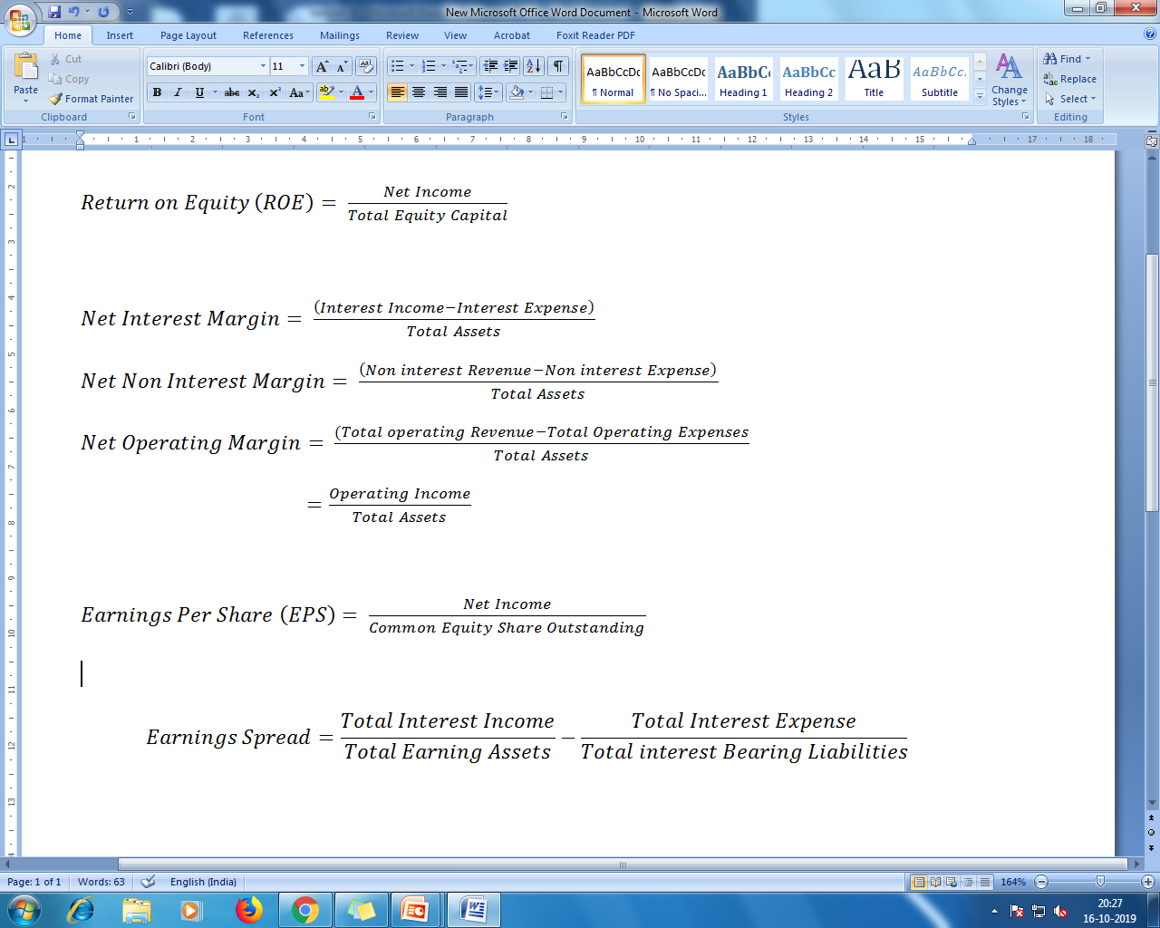
Profitability Ratios Cont..
Traditional measure of earnings efficiency
It measures the effectiveness of a firm’s intermediation function in borrowing and lending money
It also shows the intensity of competition in the market
Greater competition tends to squeeze the difference between average asset yields and average liability costs

Slide 9
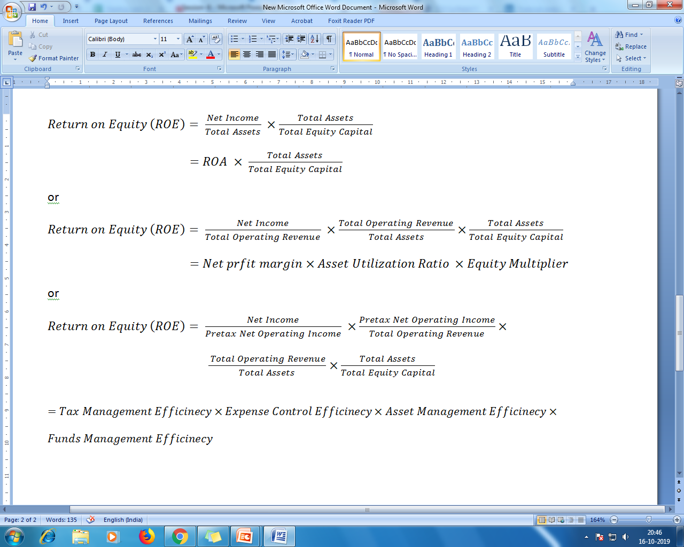
DuPont Analysis

Slide 10
Factors affecting the components of ROE
Equity multiplier (Capital structure decisions)
What sources of funding should be used?
Decisions about dividend payments
Net profit margin and Asset utilization ratio
The mix of funds raised and invested
Size of the bank
Control of operating expenses
Pricing of services
Minimization of tax liability

Slide 11
Factors affecting profitability
Bank size
Capital ratio
Risk
Funding cost
Revenue diversification
Bank age
Corporate governance
Industry structure
Business cycle

Slide 12
Stability, Asset Quality and Liquidity Measures

Slide 13
Capital Adequacy Ratio
Ratio of the bank’s capital to its risk weighted assets
Capital= Tier-I Capital + Tier-II Capital
Tier-I Capital :
Paid-up Capital
Statutory Reserves
Reserves which are not kept aside for meeting any specific liability
Surplus generated from sale of capital assets
Tier-II Capital :
Subordinate debt
General provisions and Loss reserves
Undisclosed Reserves
Perpetual preference shares

Slide 14

Asset Quality Ratio
Credit worthiness of a particular bank’s loan portfolio
Gross Non-Performing Assets (NPA) to Total Loans Ratio
Net NPA to Nat Advances
Net NPA = Gross NPA – Net Provisions on NPA and Interest on Suspense Account
Provisions for Loan Loss Ratio $=\frac{Provisions for loan losses}{Total loans}$

Slide 15
Non-Performing Assets
NPA is a loan or advance where the interest and/or installment of principal remains over due for a period more than 90 days in respect of the loan
For agricultural loans a loan granted for short duration crops will be treated as NPA if the installment of principal or interest remains overdone for two crop seasons and loan granted for long duration crops will be treated as NPA if the installment of principal and interest overdue for one crop season

Slide 16
Loan Classifications
Standard Assets: It does not disclose any problems (not NPA)
Sub-standard Assets: If the asset remained as NPA for a period less than or equal to 12 months
Doubtful Assets: If the asset remained as NPA for a period more than 12 months
Loss Assets: Loss has been identified by the bank, or internal or external auditors, or central bank but the amount has not been written off wholly or partly

Slide 17
Liquidity
Liquidity is defined as the extent to which the bank has funds available to meet cash demands for loans and deposit withdrawals
Banks require different amounts of liquidity depending on their growth rate and variability in lending and deposit activities

Slide 18

Liquidity Ratio
$Cash to Demand Deposit Ratio=\frac{Cash at Bank+Balance with Central Bank+Call Money}{Total Demand Deposit}$
$SLR Investment to Total Investment Ratio=\frac{Investments under Statutory Obligations}{Total Investments}$
$Demand to Time Deposits Ratio=\frac{Total Demand Deposits}{Total Term Deposits}$
$Credit to Deposit Ratio=\frac{Total Loans}{Total Deposits}$
Higher CD Ratio implies that bank may not have enough liquidity to
cover any unforeseen fund requirements

Slide 19
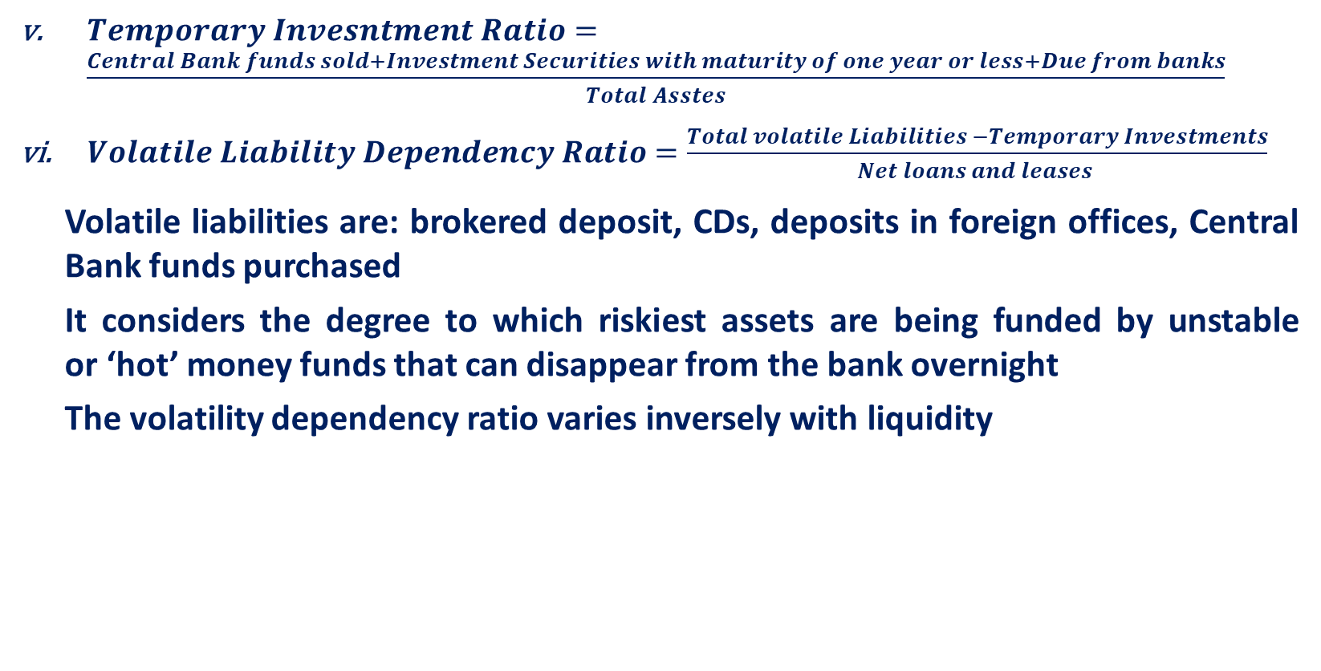
Liquidity Ratio Cont..
$Temporary Invesntment Ratio=\frac{Central Bank funds sold+Investment Securities with maturity of one year or less+Due from banks}{Total Asstes}$
$Volatile Liability Dependency Ratio=\frac{Total volatile Liabilities −Temporary Investments}{Net loans and leases }$
Volatile liabilities are: brokered deposit, CDs, deposits in foreign offices, Central Bank funds purchased
It considers the degree to which riskiest assets are being funded by unstable or ‘hot’ money funds that can disappear from the bank overnight
The volatility dependency ratio varies inversely with liquidity

Slide 20
Non-Interest Income, Expenditure and Productivity Measures

Slide 21
Non-Interest Income
Fiduciary activities
Deposit service charges
Trading revenue, venture capital revenue and securitization income
Investment banking, advisory, brokerage and underwriting fees and commissions
Insurance commission fees and income
Servicing fees for credit card, real estate, mortgage etc

Slide 22
Non-Interest Income Cont…
Net gain or loss of real estate owned or held by others
Disposal of fixed assets
Others: income from safe deposit loans, sale of bank deposits, cheques, execution of acceptances and letters of credit, credit card
Fees, foreign currency fees, penalties for early withdrawals, etc

Slide 23
Non-Interest Expenses
Personal Expenses: wages, salaries and benefits
Rent and depreciation on building and equipment
Goodwill impairment
Amortization expense and impairment losses for other intangible assets
Other operating expenses
(The sum of these five component expenses is called overhead expenses)

Slide 24
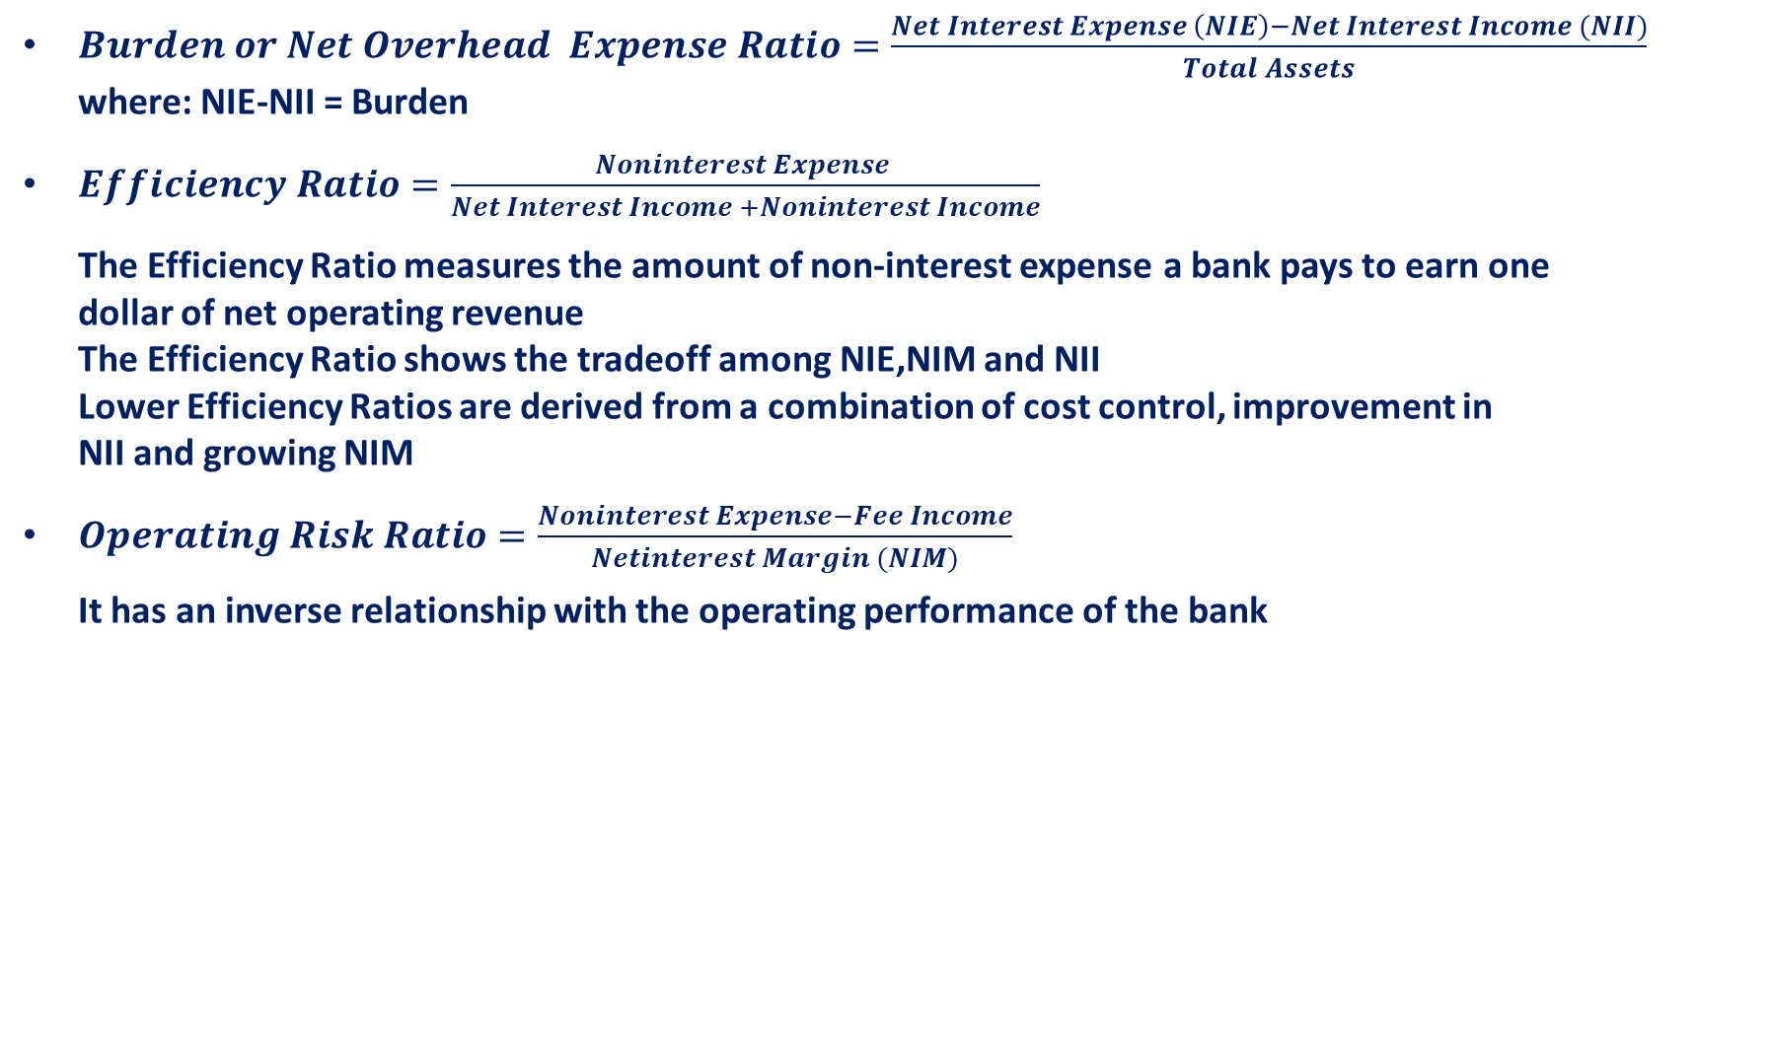
Ratios
$Burden or Net Overhead Expense Ratio=\frac{Net Interest Expense \left(NIE\right)−Net Interest Income (NII)}{Total Assets}$
where: NIE-NII = Burden
$Efficiency Ratio=\frac{Noninterest Expense }{Net Interest Income +Noninterest Income}$
The Efficiency Ratio measures the amount of non-interest expense a bank pays to earn one
dollar of net operating revenue
The Efficiency Ratio shows the tradeoff among NIE,NIM and NII
Lower Efficiency Ratios are derived from a combination of cost control, improvement in
NII and growing NIM
$Operating Risk Ratio=\frac{Noninterest Expense−Fee Income}{Netinterest Margin (NIM)}$
It has an inverse relationship with the operating performance of the bank

Slide 25

Productivity Ratios
$Assets per Employee=\frac{Average Assets}{Number of full time employees}$
Higher Assets per Employee indicates that fewer employees handle business associated with larger volume of assets
$Average Personal Expense=\frac{Personal Expenses}{Number of fulltime employees}$
The Average Personal Expenses measures the average cost of an employee when salaries and benefits are recognized
$Loan per Employee=\frac{Average Loans}{Number of fulltime employees}$
It measures the loan productivity
$Net Income per Employee=\frac{Net Income}{Number of fulltime employees}$
It measures the profitability of a bank’s workforce

Slide 26
Major Issues Related to Bank Performance
Bank Capital and Profitability
Bank Risk and Profitability
Regulations and Profitability
Monetary Policy and Profitability
Economic Uncertainty and Profitability

Slide 27
Internal Performance Evaluation and Customer Profitability Analysis

Slide 28

Internal Performance Evaluation
Evaluation is made for the different business units of banks. For example: Consumer banking, wholesale Banking and securities components
Banks evaluate line-of-business profitability and risk via Risk Adjusted Returns on Capital (RAROC) and Return on Risk Adjusted Capital (RORAC)
$RAROC=\frac{Risk−Adjusted Income}{Capital}$
The objective is to identify the measure of return generated by a line of business and compare that return to the allocated capital. The income or return may be adjusted for risk, which means that expected losses are subtracted from revenues along with other expenses

Slide 29

Internal Performance Evaluation Cont…
RAROC is used to evaluate loans and product lines and customers
Applied to pricing loans RAROC allocates equity capital depending on risk of loss, calculated a required rate of return on equity and then uses this information in pricing loans to ensure that they are profitable for the bank
$RORAC=\frac{Income}{Adjusted RIsk Capital}$
The capital is adjusted for risk which means that it represents a maximum potential loss based on the profitability of future returns or an amount necessary to cover loss associated with the volatility of earnings

Slide 30
Internal Performance Evaluation :Example (Loan Pricing)
The capital charge is determined by multiplying the equity capital allocated to the loan times the opportunity cost of equity and then converting to a pre-tax level
Let: | Cost of funds = 6%
 | Provision for loan loss = 2%
 | Direct Expenses= 0.5%
 | Indirect Expenses = 0.25%
 | Overhead expenses = 0.25%
 | Total cost before Capital charge = 9%

Slide 31
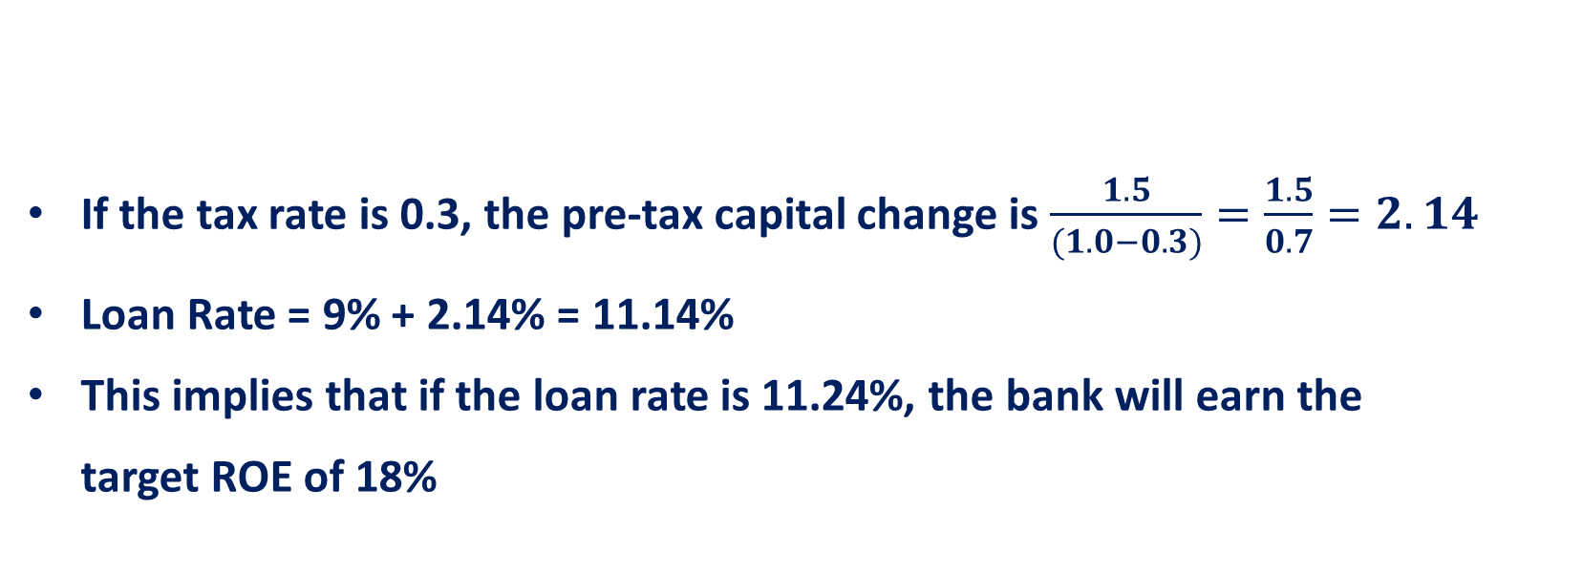
Internal Performance Evaluation :Example Cont..
Assume: | Equity to Loan Ratio = 12%
 | Opportunity Cost of Equity = 18%
 | Then after tax Capital Charge = 1.5%
If the tax rate is 0.3, the pre-tax capital change is $\frac{1.5}{(1.0−0.3)}=\frac{1.5}{0.7}=2.14$
Loan Rate = 9% + 2.14% = 11.14%
This implies that if the loan rate is 11.24%, the bank will earn the
target ROE of 18%

Slide 32
Drawbacks of Application of RAROC
It may not be possible to separate the economic costs and revenues of the different products
The production of outputs may share inputs such as land, labor and capital, which makes it impossible to individually analyze the product lines

Slide 33
Economic Value Added
It is another performance metric similar to RAROC
EVA = Adjusted earnings – Opportunity Cost of Capital
Adjusted earnings: Net income after taxes
Opportunity Cost of Capital: Cost of Equity times Equity Capital
Managers can apply EVA to loans, projects, product lines in order to evaluate whether the investment will be justifiable in terms of rewarding shareholders

Slide 34
Economic Value Added Cont..
New investments should be undertaken until the marginal contribution of the last investment is zero (i.e. EVA=0)
A higher EVA can be achieved by boosting adjusted earnings (via lowering costs, increasing sales etc.) and lowering cost of equity
RAROC compares business unit profits with the unit’s capital-at risk whereas the EVA compares business unit profit with the cost of capital

Slide 35
Customer Profitability Analysis
It is used to evaluate whether net revenue from an account meets a bank’s profit objective
General customer profitability rule is that 20% if a firm’s customers contribute about 80% of overall profits
Banks use customer profitability analysis to differentiate between the firm’s high value customers and those customers who are marginally profitable in order to move these latter customers to a more profitable position for the bank

Slide 36
Customer Profitability Analysis Cont..
Customer Profitability analysis is more often performed using monthly or quarterly historical data so that pricing can be modified where appropriate
This process involves comparing revenues from all services provided with associated costs and bank’s target profit

Slide 37
Customer Profitability Analysis Cont..
If Revenue > Expenses + Target Profit, the account generates a return in excess of the minimum return required by the bank
If Revenue = Expenses + Target Profit, the account just meets the required return objective
If Revenue < Expenses, the account is clearly unprofitable
If Revenue < Expenses + Target Profit, the account is profitable, but does not generate the minimum acceptable return to the bank

Slide 38
Steps for Evaluating Customer Profitability
Identify the full list of services used by a customer such as transactions account activity, extension of credit, security safekeeping, letter of credit, safe deposit boxes etc.
Assess the cost of providing each service
No systematic method for allocation of fixed cost so estimation of unit cost is the best way

Slide 39
Cost Management Strategies and Transfer Pricing

Slide 40
Cost Management Strategies
Expense reduction
Operating efficiencies
Revenue enhancement
Contribution growth

Slide 41
Expense Reduction
Reduction of non-profit generating branch and medical benefits of employees
Outsourcing the data processing services
Use of temporary or contractual workers
Elimination of redundant tasks
Digitalization of the system

Slide 42
Operating Efficiencies
Reduction of costs but maintaining the existing level of products and services
Increasing the level of output but maintaining the level of current expenses
Improvement of workflow

Slide 43
Mechanism of Attaining Operating Efficiency
Reducing workforce
Increasing work requirements
Economies of Scale: It is said to exist when a bank’s average cost decreases as output increases
Economies of Scope: How the joint cost of providing several products change as new products are added and existing output is enhanced. The argument is that joint costs will grow by much less than the costs allocated with producing products or providing services independently

Slide 44
Revenue Enhancement
Changing the price of specific products and services with high volume of business
Identification of products and services that exhibit price inelastic demand
Increase in price reduces the demand of the product
Proportionate decrease in demand is less than the proportionate increase in price
Expansion of volume keeping price constant
Enlarging the base of the consumers by increasing product quality

Slide 45
Contributing Growth
Allocation of resources to improve the overall long-term profitability
Increase in expenditure should be associated with increase in associated revenues
Example: Investment in new technology, digitalization of the system etc.

Slide 46
Transfer Price
It is an internal rate of interest used to calculate transfer income or cost due to an internal flow of funds in a bank
There is a transfer cost for each loan and transfer income for each deposit
The difference between interest rate and transfer price is called interest margin which allows to calculate the internal interest profit on a transaction

Slide 47
Methodologies of Transfer Price
Single Pool Method: Same one and only transfer price rate is assigned to all loans and deposits. There is no difference in pricing products with various repricing and maturity characteristics.
In this method the transfer price is the weighted average rate of interest of all assets and liabilities of the bank
Double Pool Method (Split Pools): Average loan rate is used as transfer price for loans and mean deposit rate is used as transfer price for deposits

Slide 48
Methodologies of Transfer Price Cont..
Multiple Pool Method: Products are divided into different pools on the basis of maturity. The bank establishes a set of transfer price for each product pool, i.e. one price for each pool. It is calculated as the average interest rate on assets and deposits in each pool
At any point of time, the rates prevailing in the market is accepted as the cost of funds suitable for the bank
The transfer price assigned to each pool is based on its maturity and market rates prevailing for its term.

Slide 49
Methodologies of Transfer Price Cont..
For assets, which carry the interest income the TP is negative in order to calculate the cost of the fund For liabilities bearing interest costs, the TP is positive, which shows the internal income attributed to funds raised
Depending on market interest rates, transfer prices change from one period to another and the length of the period needs to be determined.
Matched Rate Method: In this method prices are assigned to each transactions separately instead of pooled transactions

